Slide 1

BOUN RUA SETUR DATATHON
RAMİZ DÜNDAR
UMUT KOCASARI
ALİ RAMAZAN MERT

Slide 2
WHY RECOMMENDATION SYSTEMS?
According to a McKinsey report, 35% of all Amazon’s transactions come from algorithmical product recommendations.

Slide 3
- Google Finance, Yahoo Finance, MSN Money
«Judging by Amazon’s success, the recommendation system works. The company reported a 29% sales increase to $12.83 billion during its second fiscal quarter, up from $9.9 billion during the same last year.»

Slide 4
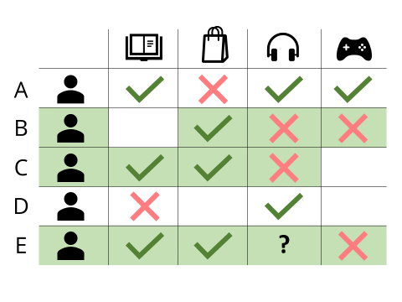

Slide 5
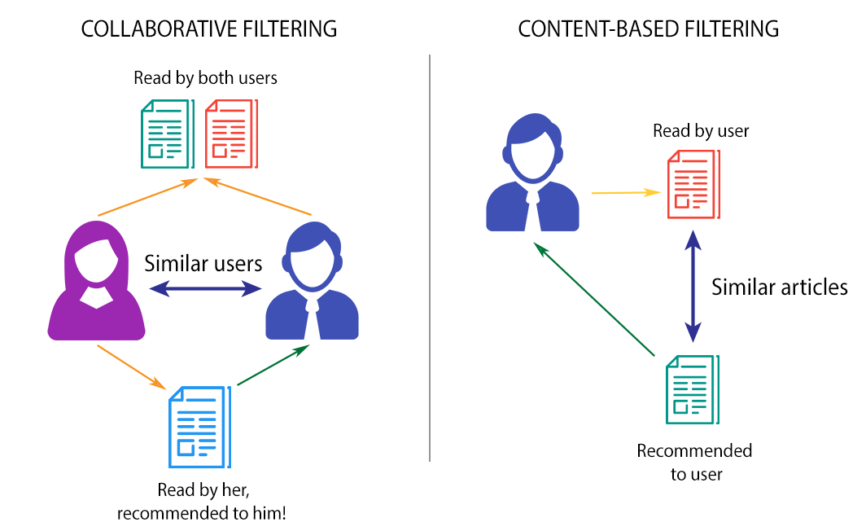

Slide 6
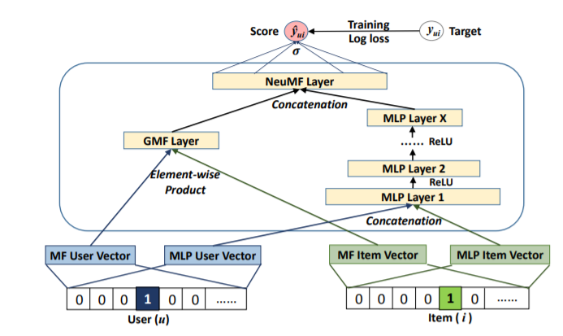
COLLABORATIVE FILTERING
%88 ACCURACY

Slide 7
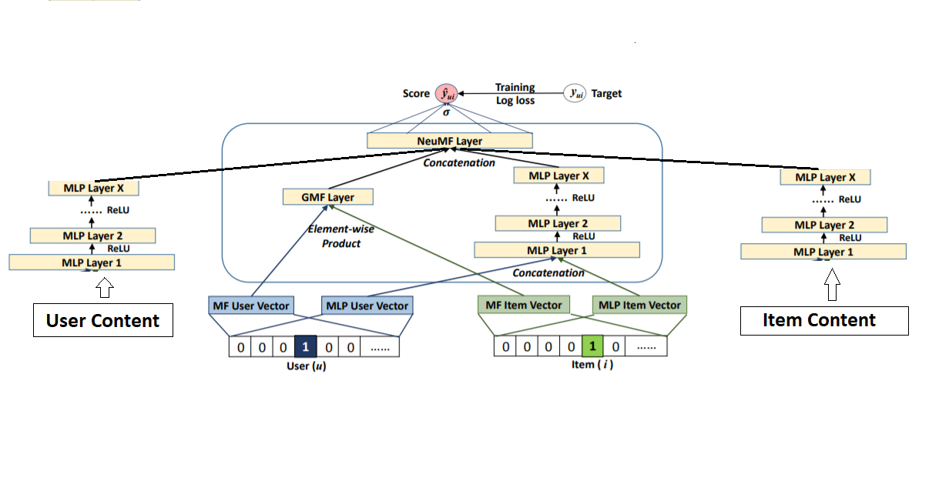
HYBRID MODEL
%93 ACCURACY

Slide 8
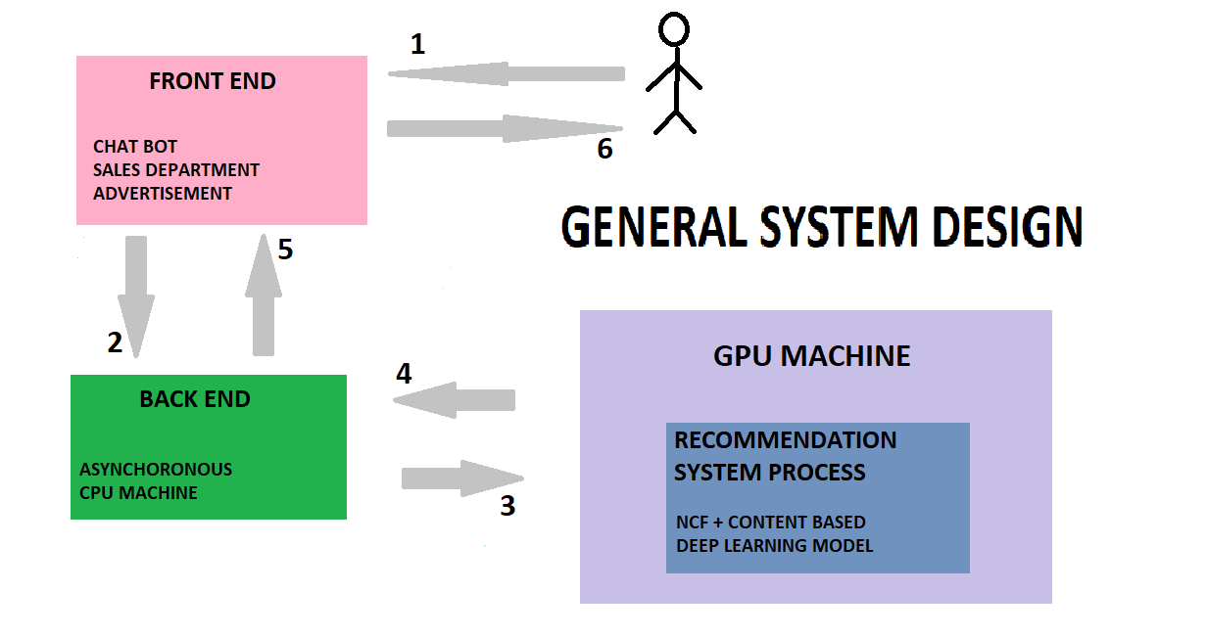
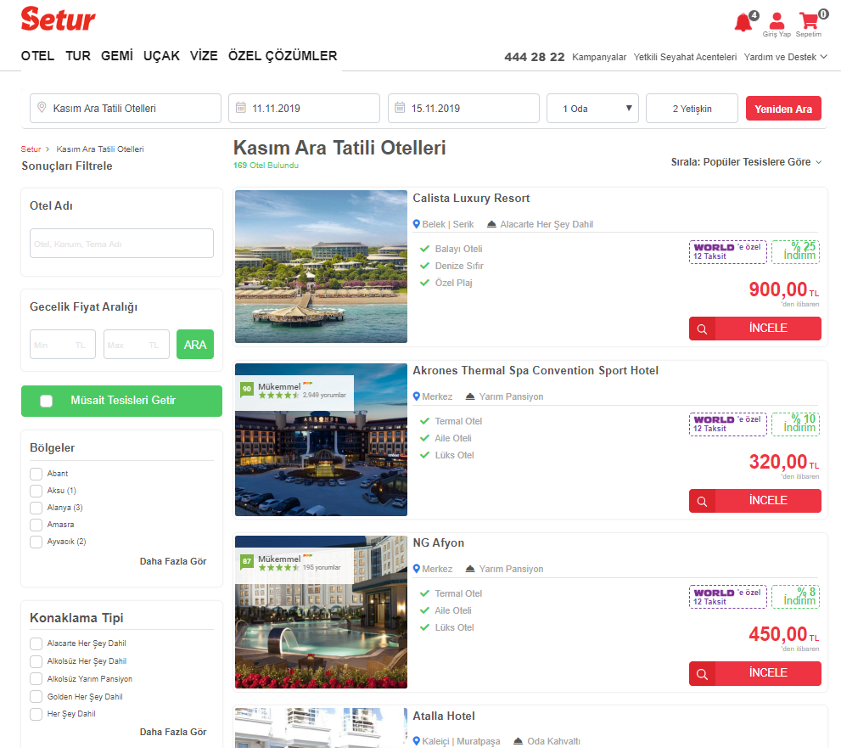

Slide 9
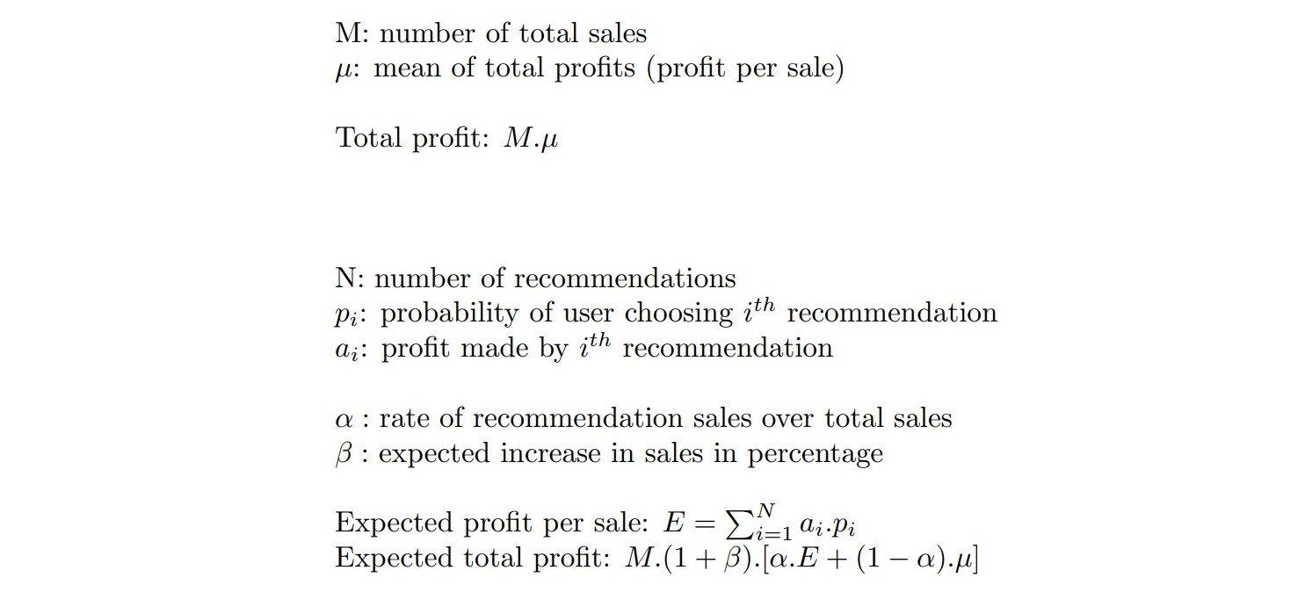

Slide 10
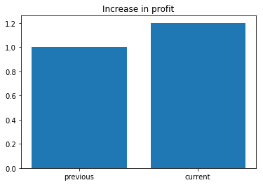
RESULTS
Expected increase in profit is approximately %21.

Slide 11
SUMMARY
DATA RESEARCH
MODEL SELECTION
PROFIT MAXIMIZATION
SYSTEM DESIGN
ESTIMATION OF PROFIT

Slide 12

THANK YOU

